Slide 1
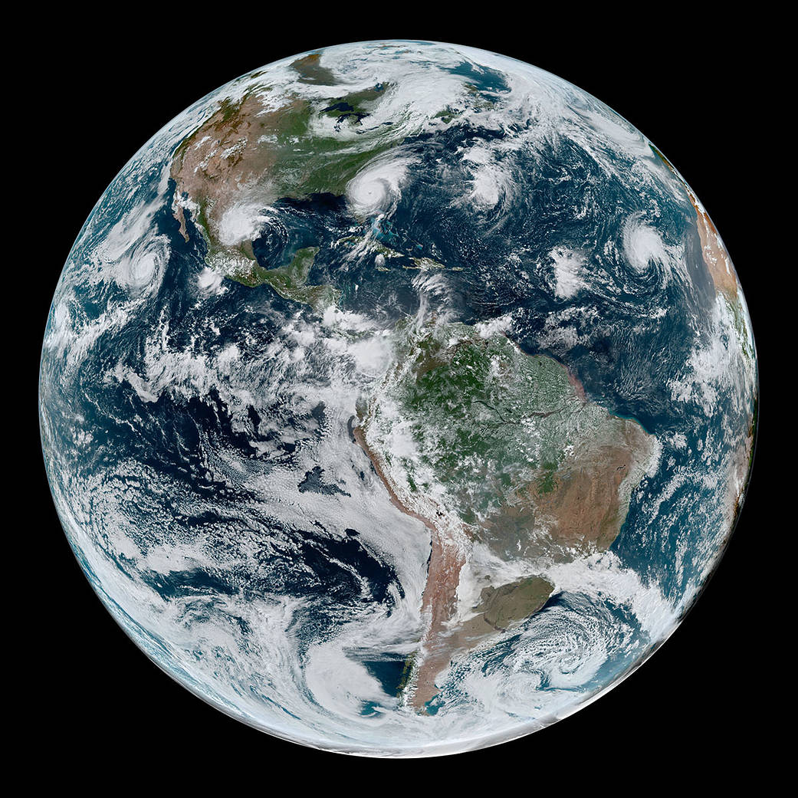
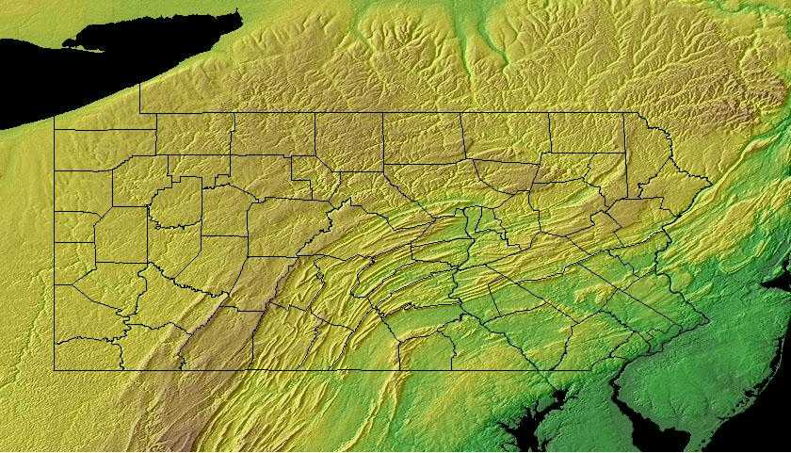
Regional Climate Change Impacts: What Science Tells Us
Raymond Najjar
The Pennsylvania State University
The p4 Pittsburgh Climate Action Summit
October 30, 2019
Notes:
https://www.nasa.gov/topics/earth/images/index.html
Geology.com

Slide 2
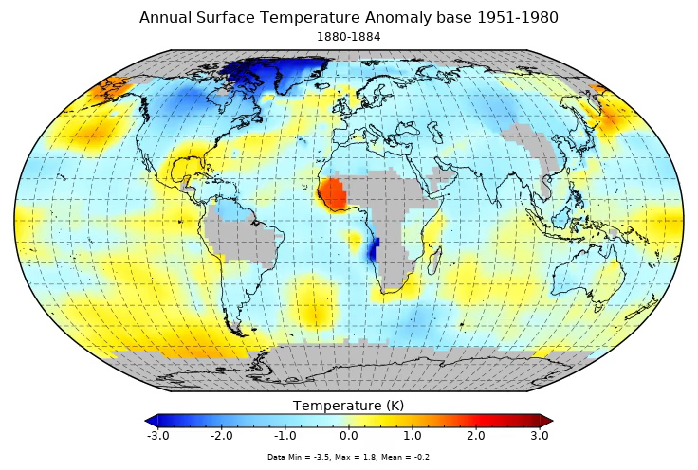
The world is warming almost everywhere
Source: NASA
Notes:
https://data.giss.nasa.gov/gistemp/animations/

Slide 3
Sea level is accelerating
Year
Columbia University Earth Institute
Notes:
http://www.columbia.edu/~mhs119/SeaLevel/

Slide 4
Multiple lines of evidence of a warming world
1940 1960 1980 2000 1940 1960 1980 2000 1940 1960 1980 2000
Year
Fourth National Climate Assessment
Wuebbles et al. (2017)
Notes:
Wuebbles, D.J., Easterling, D.R., Hayhoe, K., Knutson, T., Kopp, R.E., Kossin, J.P., Kunkel, K.E., LeGrande, A.N., Mears, C., Sweet, W.V., Taylor, P.C., Vose, R.S., Wehner, M.F., 2017. Our globally changing climate. In: D.J. Wuebbles, D.W. Fahey, K.A. Hibbard, D.J. Dokken, B.C. Stewart, T.K. Maycock (Editors), Climate Science Special Report: Fourth National Climate Assessment, Volume I. U.S. Global Change Research Program, Washington, DC, USA, pp. 35–72.

Slide 5
We cannot explain observed warming with natural drivers …
1951–1980 average
Fourth National Climate Assessment, Hayhoe et al. (2018)
Notes:
Hayhoe, K., Wuebbles, D.J., Easterling, D.R., Fahey, D.W., Doherty, S., Kossin, J., Sweet, W., Vose, R., Wehner, M., 2018. Our changing climate. In: D.R. Reidmiller, C.W. Avery, D.R. Easterling, K.E. Kunkel, K.L.M. Lewis, T.K. Maycock, B.C. Stewart (Editors), Impacts, Risks, and Adaptation in the United States: Fourth National Climate Assessment. US Global Change Research Program, Washington, DC, USA, pp. 72–144.

Slide 6
… but we can with human drivers
1951–1980 average
Fourth National Climate Assessment, Hayhoe et al. (2018)
Notes:
Hayhoe, K., Wuebbles, D.J., Easterling, D.R., Fahey, D.W., Doherty, S., Kossin, J., Sweet, W., Vose, R., Wehner, M., 2018. Our changing climate. In: D.R. Reidmiller, C.W. Avery, D.R. Easterling, K.E. Kunkel, K.L.M. Lewis, T.K. Maycock, B.C. Stewart (Editors), Impacts, Risks, and Adaptation in the United States: Fourth National Climate Assessment. US Global Change Research Program, Washington, DC, USA, pp. 72–144.

Slide 7


1. Solar radiation warms Earth
The greenhouse effect in three steps
2. Earth’s radiation absorbed in atmosphere
3. Atmosphere’s radiation further warms Earth—by 60 ºF

Slide 8
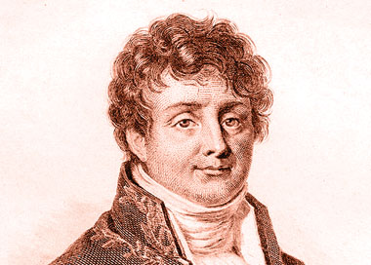
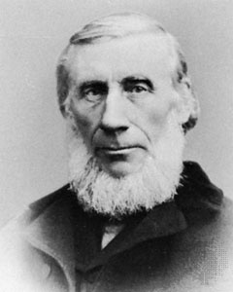
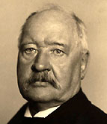
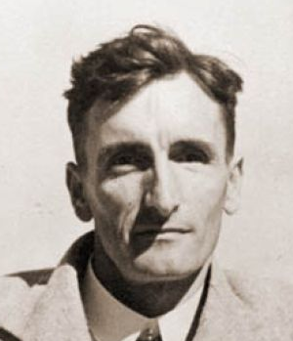
The greenhouse effect is well established
1824: Joseph Fourier describes natural greenhouse effect
1858–1861: Eunice Foote and John Tyndall identify greenhouse gases
1896: Svante Arrenhius estimates greenhouse effect of fossil fuel CO₂
1938: Guy Callendar documents warming and CO₂ increase

Slide 9
“Many lines of evidence demonstrate that it is extremely likely that human influence has been the dominant cause of the observed warming since the mid-20th century.”
“For the period extending over the last century, there are no convincing alternative explanations supported by the extent of the observational evidence.”
Fourth National Climate Assessment, Wuebbles et al. (2017)
Notes:
Wuebbles, D.J., Easterling, D.R., Hayhoe, K., Knutson, T., Kopp, R.E., Kossin, J.P., Kunkel, K.E., LeGrande, A.N., Mears, C., Sweet, W.V., Taylor, P.C., Vose, R.S., Wehner, M.F., 2017. Our globally changing climate. In: D.J. Wuebbles, D.W. Fahey, K.A. Hibbard, D.J. Dokken, B.C. Stewart, T.K. Maycock (Editors), Climate Science Special Report: Fourth National Climate Assessment, Volume I. U.S. Global Change Research Program, Washington, DC, USA, pp. 35–72.

Slide 10
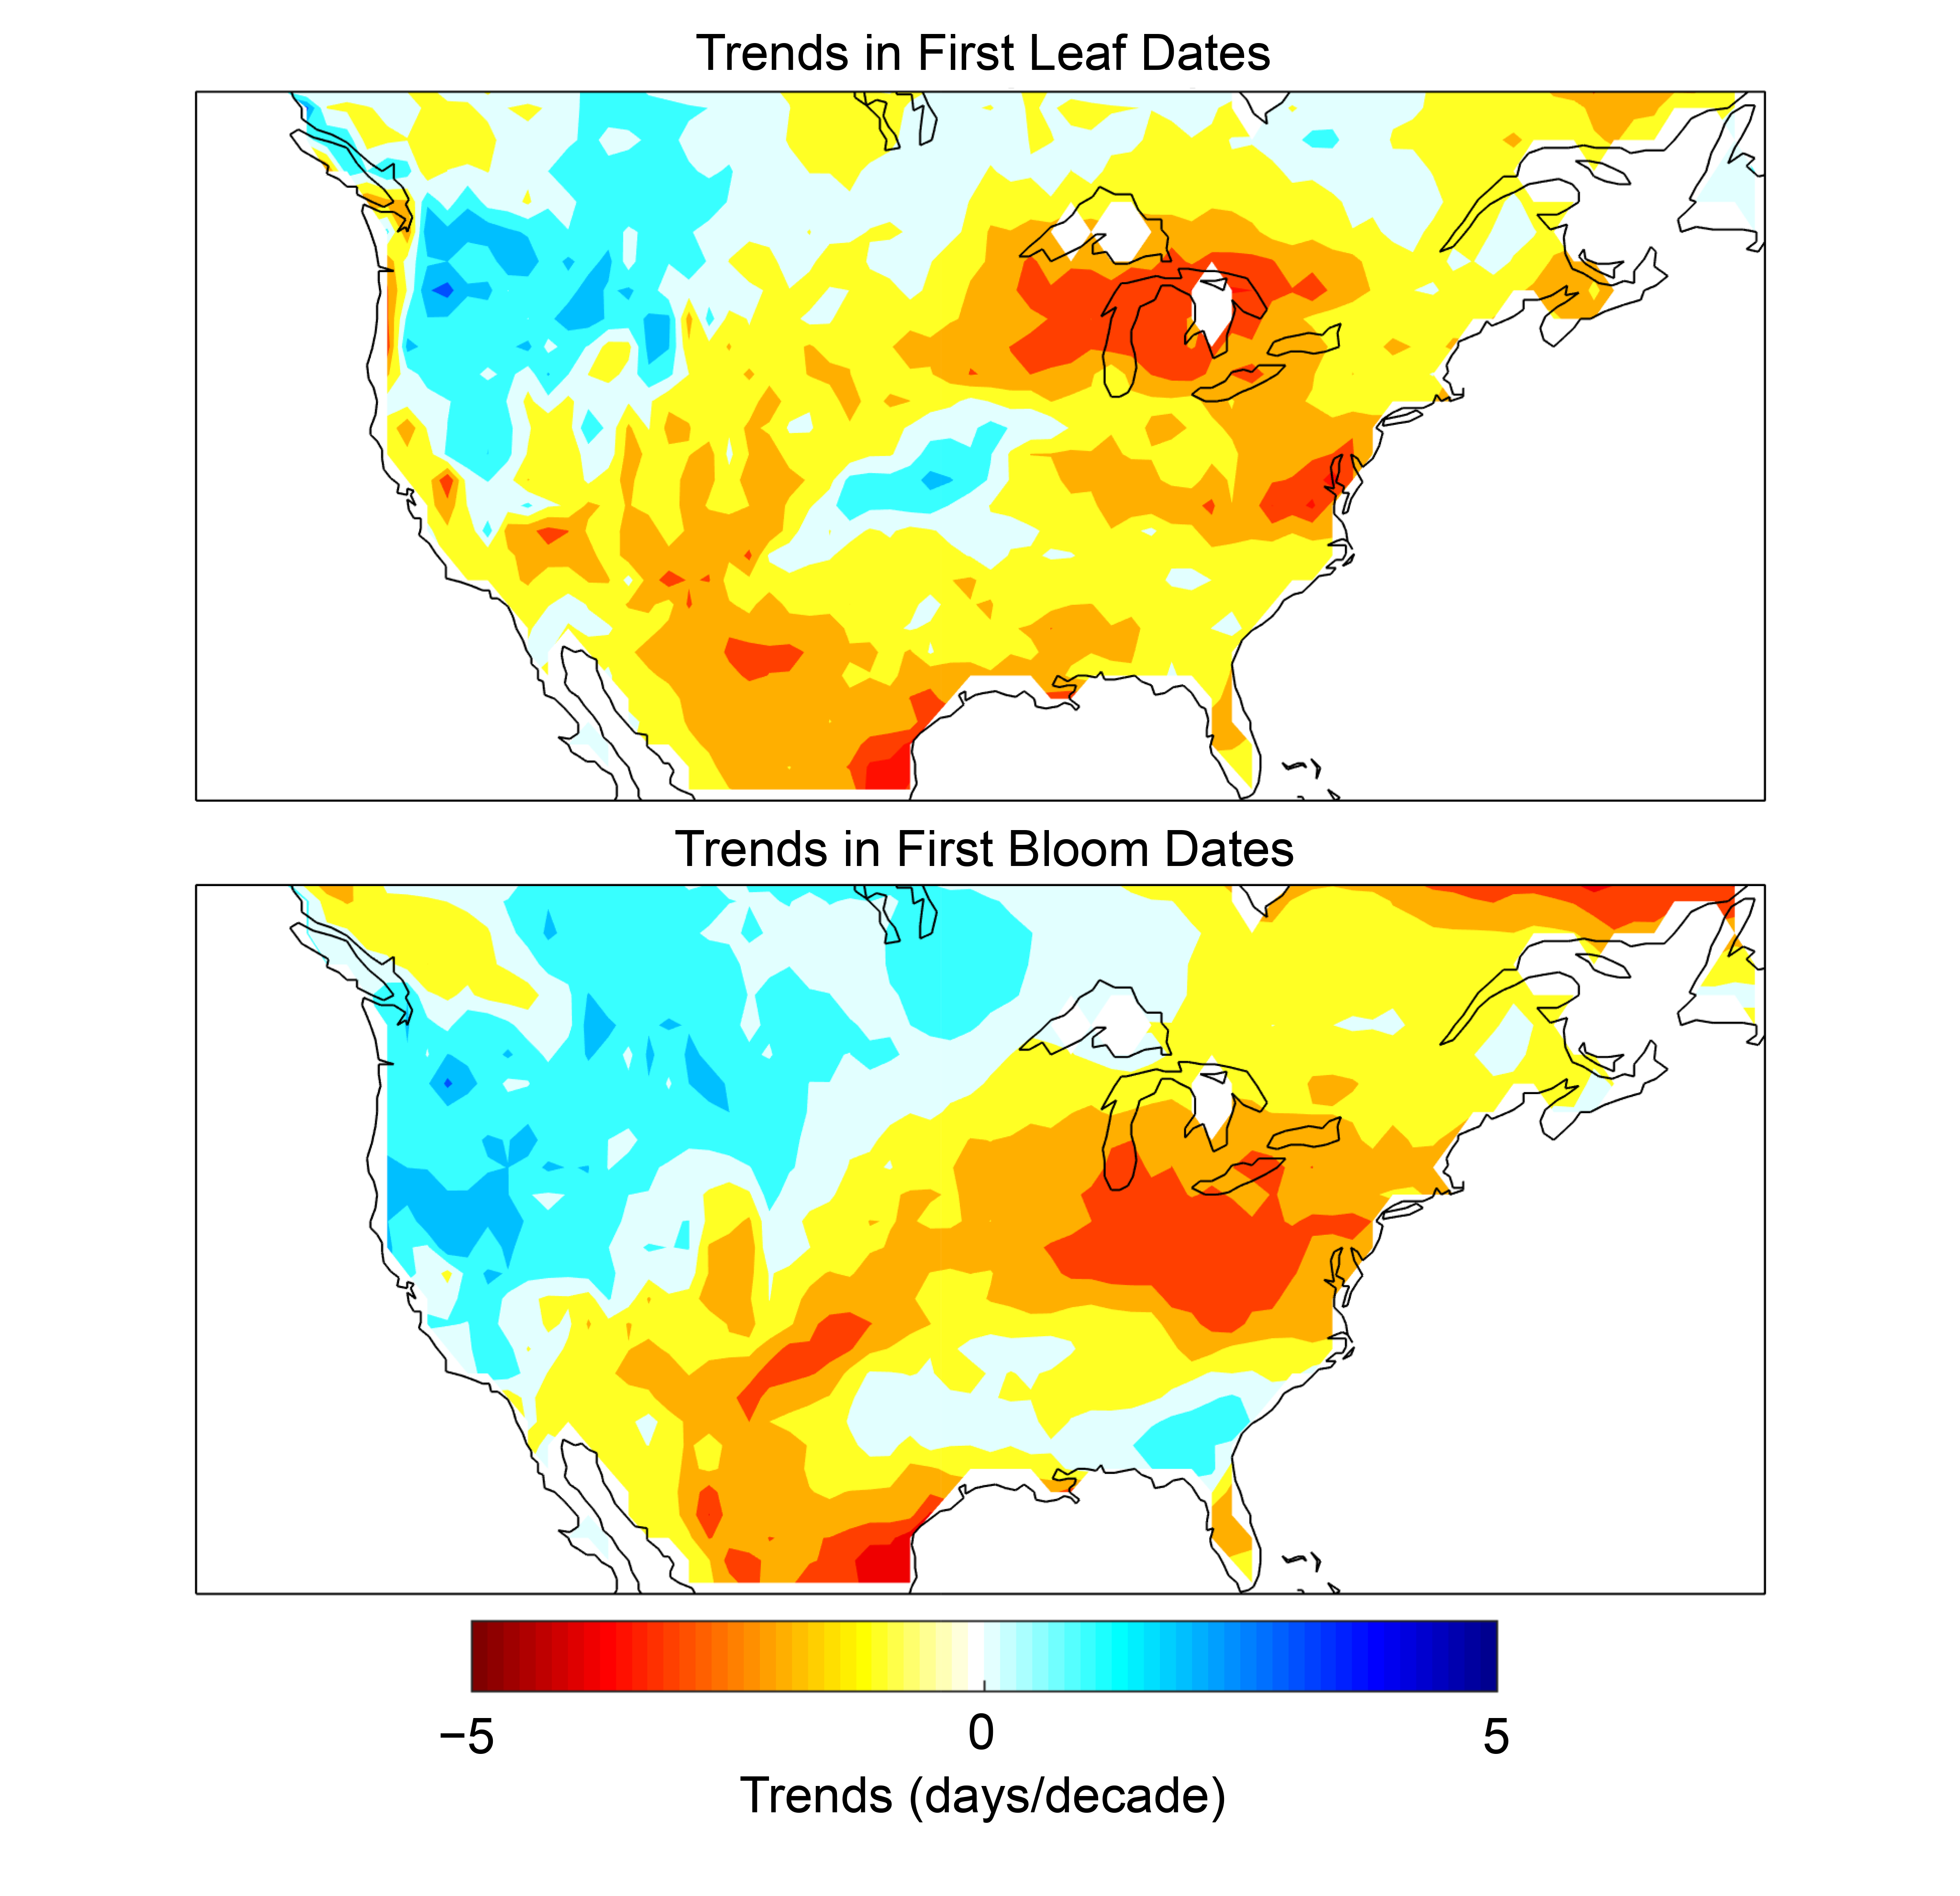
Plants are leafing out and blooming earlier
1981–2010 trends of three indicator plants
First leaf First bloom
Fourth National Climate Assessment, Lipton et al. (2018)
Notes:
Lipton, D., M. A. Rubenstein, S.R. Weiskopf, S. Carter, J. Peterson, L. Crozier, M. Fogarty, S. Gaichas, K.J.W. Hyde, T.L. Morelli, J. Morisette, H. Moustahfid, R. Muñoz, R. Poudel, M.D. Staudinger, C. Stock, L. Thompson, R. Waples, and J.F. Weltzin, 2018: Ecosystems, Ecosystem Services, and Biodiversity. In Impacts, Risks, and Adaptation in the United States: Fourth National Climate Assessment, Volume II [Reidmiller, D.R., C.W. Avery, D.R. Easterling, K.E. Kunkel, K.L.M. Lewis, T.K. Maycock, and B.C. Stewart (eds.)]. U.S. Global Change Research Program, Washington, DC, USA, pp. 268–321. doi: 10.7930/NCA4.2018.CH7

Slide 11
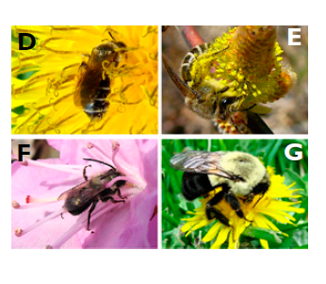
Native bees in Northeast US are arriving in spring 10 days earlier than they used to
A. miserabilis
C. inaequalis
O. lignaria
B. impatiens
Bartomeus et al. (2011)
Notes:
Bartomeus, I., Ascher, J.S., Wagner, D., Danforth, B.N., Colla, S., Kornbluth, S., Winfree, R., 2011. Climate-associated phenological advances in bee pollinators and bee-pollinated plants. Proceedings of the National Academy of Sciences 108, 20645-20649.

Slide 12
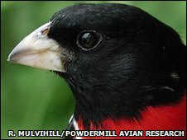
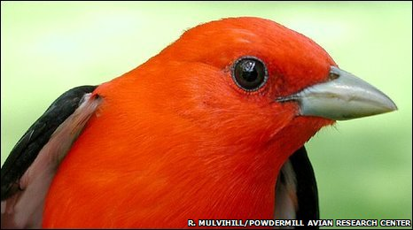
Birds in Western PA became smaller by 1.3% on average due to warming from 1961 to 2007
Scarlet tanager: 2% smaller
Rose-breasted grossbeak: 2% smaller
Van Buskirk et al. (2009, 2010)
Notes:
Van Buskirk, J., Mulvihill, R.S., Leberman, R.C., 2010. Declining body sizes in North American birds associated with climate change. Oikos 119, 1047-1055.
Van Buskirk, J., Mulvihill, R.S., Leberman, R.C., 2009. Variable shifts in spring and autumn migration phenology in North American songbirds associated with climate change. Global Change Biology 15, 760-771.

Slide 13
The ratio of snow to total precipitation is mostly decreasing in the Northeast US
1949–2005 trend
Decreasing
Increasing
Feng and Hu (2007)
Notes:
Feng, S., Hu, Q., 2007. Changes in winter snowfall/precipitation ratio in the contiguous United States. Journal of Geophysical Research: Atmospheres 112, doi: 10.1029/2007jd008397.

Slide 14
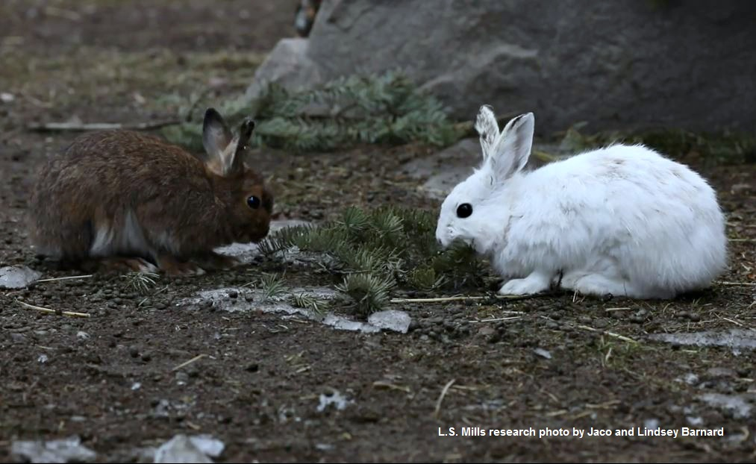
With warming and snowpack reduction, Snowshoe Hare range in Pennsylvania has contracted
Diefenbach et al. (2016), Fourth National Climate Assessment (Lipton et al. 2018)
Notes:
Diefenbach, D.R., Rathbun, S.L., Vreeland, J.K., Grove, D., Kanapaux, W.J., 2016. Evidence for range contraction of snowshoe hare in Pennsylvania. Northeastern Naturalist 23, 229-249.
Lipton, D., M. A. Rubenstein, S.R. Weiskopf, S. Carter, J. Peterson, L. Crozier, M. Fogarty, S. Gaichas, K.J.W. Hyde, T.L. Morelli, J. Morisette, H. Moustahfid, R. Muñoz, R. Poudel, M.D. Staudinger, C. Stock, L. Thompson, R. Waples, and J.F. Weltzin, 2018: Ecosystems, Ecosystem Services, and Biodiversity. In Impacts, Risks, and Adaptation in the United States: Fourth National Climate Assessment, Volume II [Reidmiller, D.R., C.W. Avery, D.R. Easterling, K.E. Kunkel, K.L.M. Lewis, T.K. Maycock, and B.C. Stewart (eds.)]. U.S. Global Change Research Program, Washington, DC, USA, pp. 268–321. doi: 10.7930/NCA4.2018.CH7
Photo credit: L. S. Mills research photo by Jaco and Lindsey Barnard, University of Montana Mills Research Lab.

Slide 15
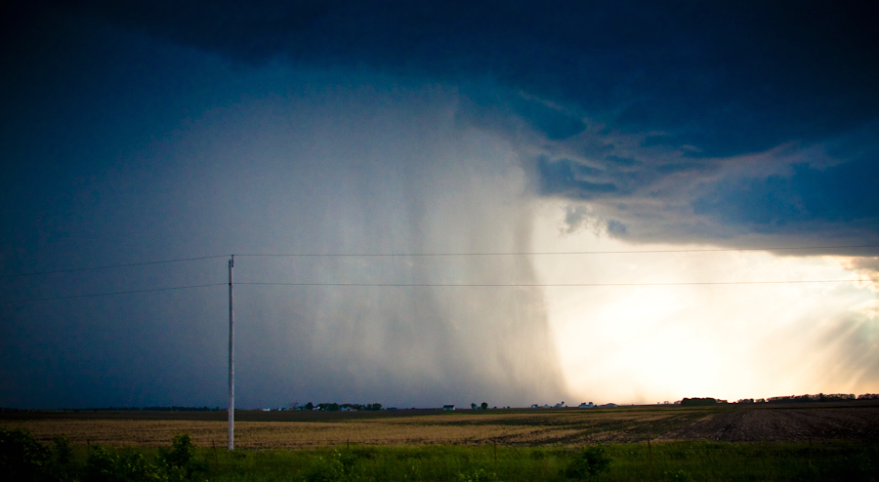
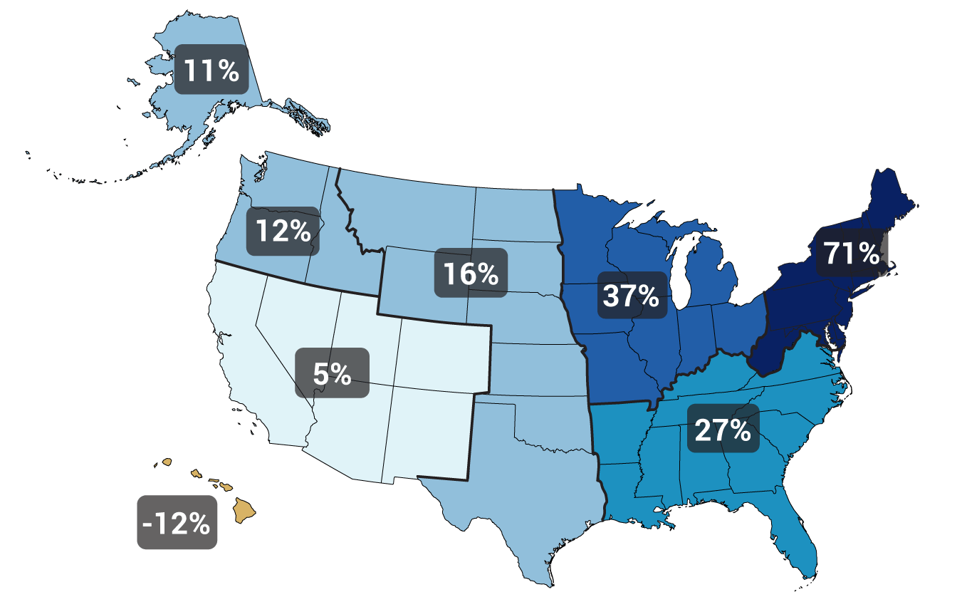
Heavy precipitation is increasing
Gustoflight.wordpress.com
Change in top 1% of rainiest days from 1958 to 2012
Walsh et al. (2014)
Notes:
Walsh, J., Wuebbles, D., Hayhoe, K., Kossin, J., Kunkel, K., Stephens, G., Thorne, P., Vose, R., Wehner, M., Willis, J., Anderson, D., Doney, S., Feely, R., Hennon, P., Kharin, V., Knutson, T., Landerer, F., Lenton, T., Kennedy, J., Somerville, R., 2014. Chapter 2: Our Changing Climate. In: J.M. Melillo, T.C. Richmond, G.W. Yohe (Editors), Climate Change Impacts in the United States: The Third National Climate Assessment. U.S. Global Change Research Program, pp. 19-67.

Slide 16
Three possible emissions futures …
Fourth National Climate Assessment, Wuebbles et al. (2017)
Notes:
Wuebbles, D.J., Easterling, D.R., Hayhoe, K., Knutson, T., Kopp, R.E., Kossin, J.P., Kunkel, K.E., LeGrande, A.N., Mears, C., Sweet, W.V., Taylor, P.C., Vose, R.S., Wehner, M.F., 2017. Our globally changing climate. In: D.J. Wuebbles, D.W. Fahey, K.A. Hibbard, D.J. Dokken, B.C. Stewart, T.K. Maycock (Editors), Climate Science Special Report: Fourth National Climate Assessment, Volume I. U.S. Global Change Research Program, Washington, DC, USA, pp. 35–72.

Slide 17
… lead to very different climate futures
Fourth National Climate Assessment, Wuebbles et al. (2017)
Notes:
Wuebbles, D.J., Easterling, D.R., Hayhoe, K., Knutson, T., Kopp, R.E., Kossin, J.P., Kunkel, K.E., LeGrande, A.N., Mears, C., Sweet, W.V., Taylor, P.C., Vose, R.S., Wehner, M.F., 2017. Our globally changing climate. In: D.J. Wuebbles, D.W. Fahey, K.A. Hibbard, D.J. Dokken, B.C. Stewart, T.K. Maycock (Editors), Climate Science Special Report: Fourth National Climate Assessment, Volume I. U.S. Global Change Research Program, Washington, DC, USA, pp. 35–72.

Slide 18
Pennsylvania is following the global trend
Frankson et al. (2017)
Notes:
Frankson, R., Kunkel, K., Champion, S., Stewart, B., DeGaetano, A.T., Sweet, W., 2017. Pennsylvania State Climate Summary. NOAA Technical Report NESDIS 149-PA, 4 pp.

Slide 19
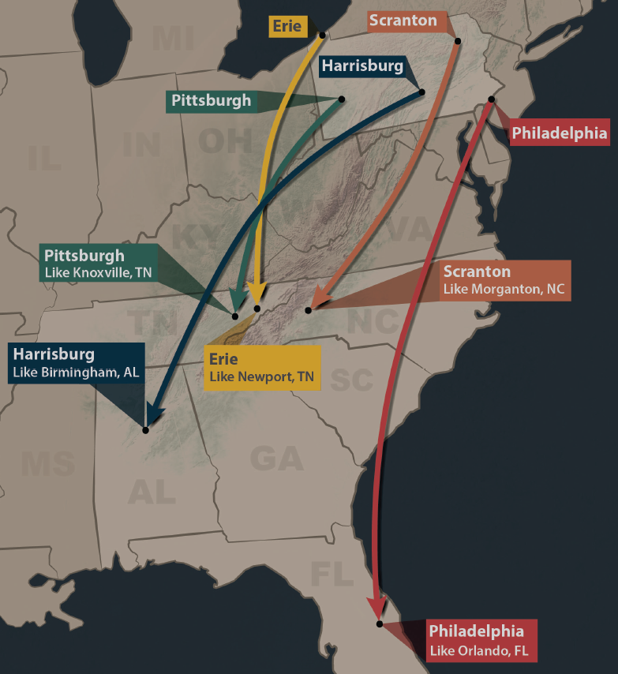
Summers in Pennsylvania will feel like those of the Southeast US by mid-century if heat trapping emissions trends continue
http://psiee.psu.edu/climate-impacts
Notes:
http://psiee.psu.edu/climate-impacts

Slide 20
Emissions really matter, especially in the long run
Union of Concerned Scientists (2008)
Notes:
Union of Concerned Scientists, 2008. Climate Change in Pennsylvania: Impacts and Solutions for the Keystone State. Cambridge, MA, 54 pp.

Slide 21
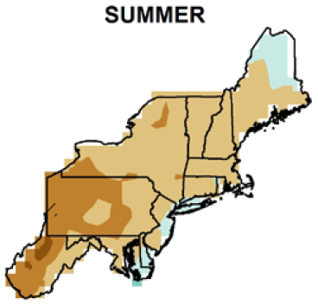
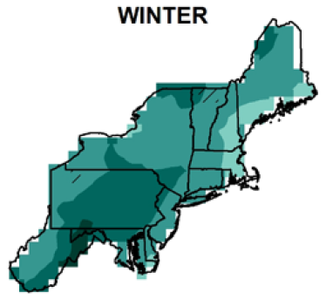

Expect summers to be drier …
… and winters to be wetter
0
8
12
-4
16
Percent precipitation change by 2050s
Kunkel et al. (2013)
Notes:
Kunkel, K.E., Stevens, L.E., Stevens, S.E., Sun, L., Janssen, E., Wuebbles, D., Rennells, J., DeGaetano, A., Dobson, J.G., 2013. Regional Climate Trends and Scenarios for the U.S. National Climate Assessment, Part 1. Climate of the Northeast U.S., NOAA Technical Report NESDIS 142-1. U.S. Department of Commerce, Washington, D.C., 79 pp.

Slide 22
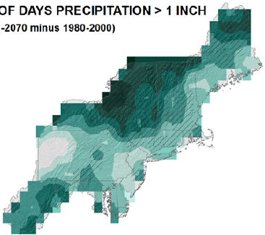

Expect heavy downpours to continue to increase
Percent change by 2050s in days > 1”
21
27
21
15
Kunkel et al. (2013)
Notes:
Kunkel, K.E., Stevens, L.E., Stevens, S.E., Sun, L., Janssen, E., Wuebbles, D., Rennells, J., DeGaetano, A., Dobson, J.G., 2013. Regional Climate Trends and Scenarios for the U.S. National Climate Assessment, Part 1. Climate of the Northeast U.S., NOAA Technical Report NESDIS 142-1. U.S. Department of Commerce, Washington, D.C., 79 pp.

Slide 23
Projected change in downhill skiing season length by 2090
Low emissions
High emissions
RCP 4.5
RCP 8.5
Wobus et al. (2017)
Notes:
Wobus, C., Small, E.E., Hosterman, H., Mills, D., Stein, J., Rissing, M., Jones, R., Duckworth, M., Hall, R., Kolian, M., 2017. Projected climate change impacts on skiing and snowmobiling: A case study of the United States. Global environmental change 45, 1-14.

Slide 24
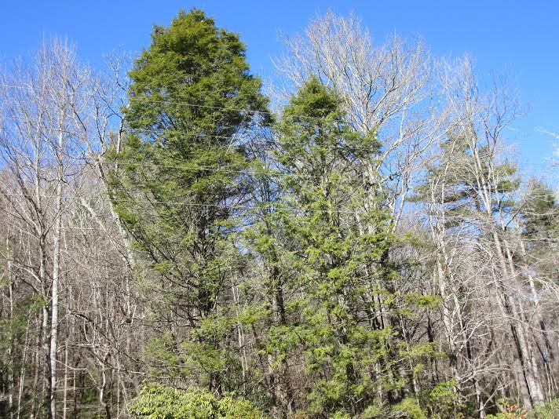
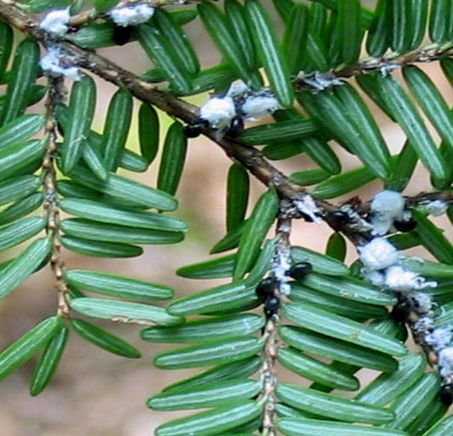
The wooly adelgid harms the Eastern Hemlock tree (PA state tree)
savinghemlocks.org

Slide 25
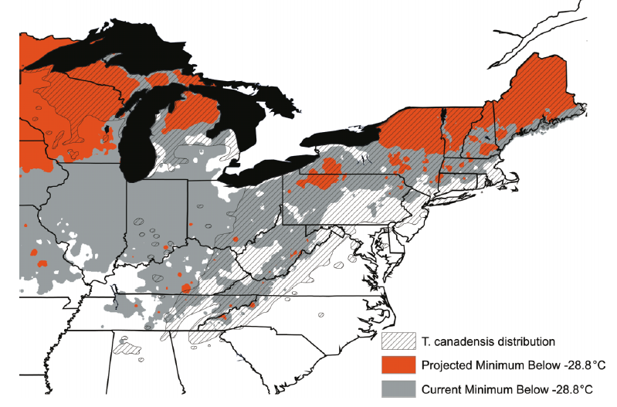
Warming winters allow the wooly adelgid to do more damage
&
Hemlock safe today
Hemlock safe in 2070
Dukes et al. (2009)
A2 scenario, 2070, average of nine GCMs
Notes:
Dukes, J.S., Pontius, J., Orwig, D., Garnas, J.R., Rodgers, V.L., Brazee, N., Cooke, B., Theoharides, K.A., Stange, E.E., Harrington, R., 2009. Responses of insect pests, pathogens, and invasive plant species to climate change in the forests of northeastern North America: What can we predict? Canadian Journal of Forest Research 39, 231-248.

Slide 26
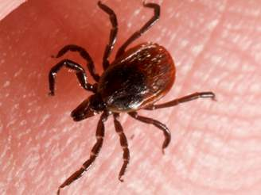
In Millbrook, NY, warming has led to an earlier larval peak of the blacklegged (deer) tick, the major Lyme disease transmitter
Earlier larval peak
Cumulative degree days through August
Warmer years
Levi et al. (2015)
Notes:
Levi, T., Keesing, F., Oggenfuss, K., Ostfeld, R.S., 2015. Accelerated phenology of blacklegged ticks under climate warming. Philosophical Transactions of the Royal Society B: Biological Sciences 370, 20130556.

Slide 27
We have cleaned up our own messes before

Slide 28
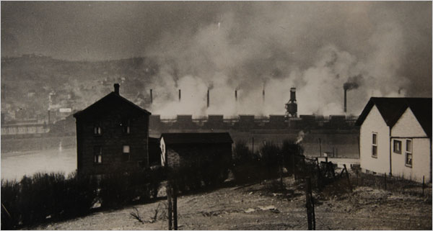
“Smog episodes”
October 1948: Pollution from zinc mills in Donora, PA combined with a temperature inversion, leads to 20 deaths
Source: Donora Smog Museum

Slide 29
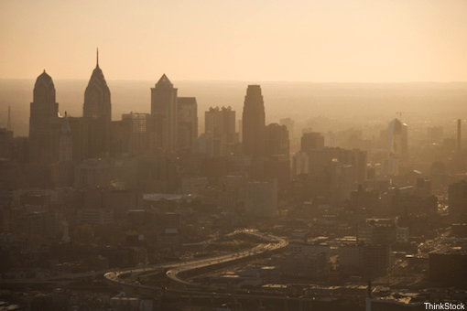
This is happening much less often than it used to because …
Ozone
NO₂
CO
SO₂
Lead
28%
52%
82%
83%
89%
Median change in US: 1980-2010
Data source: www3.epa.gov/airtrends

Slide 30
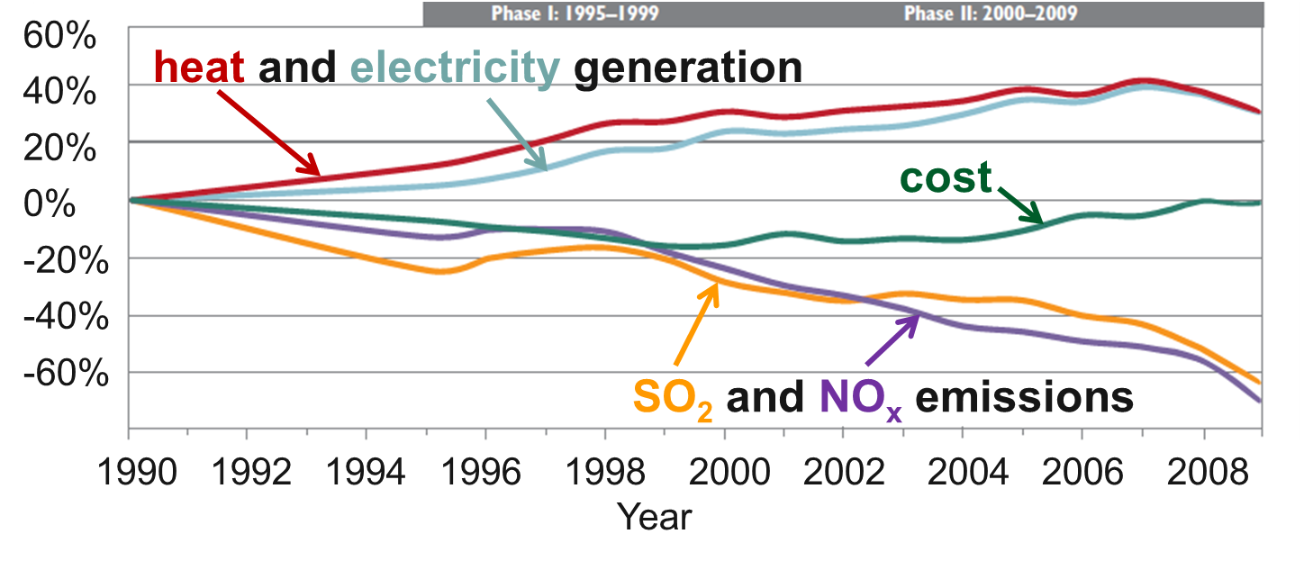
The Clean Air act reduced emissions and created $170 - $430 billion per year in health benefits—all while energy use went up and costs went down!
Burns et al. (2011)
Notes:
Burns, D.A., Baron, J.S., Cosby, B.J., Fenn, M.E., Lynch, J.A., 2011. National Acid Precipitation Assessment Program Report to Congress 2011: An Integrated Assessment. National Science and Technology Council, United States Government, Washington, D.C., 114 pp.

Slide 31
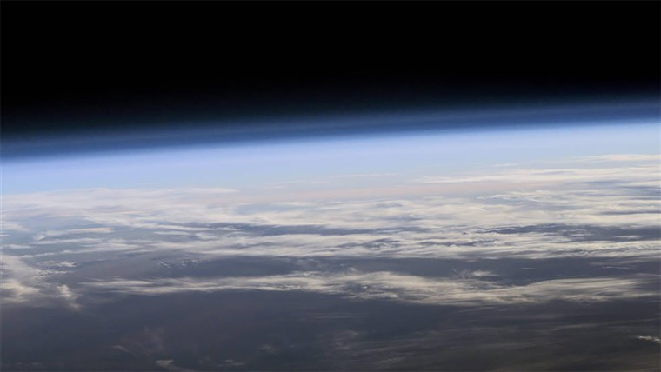
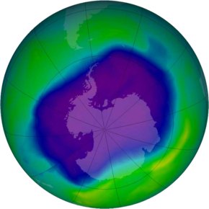
Good news: the ozone hole is shrinking!
NASA
Notes:
NASA image
https://ozonewatch.gsfc.nasa.gov/statistics/annual_data.html

Slide 32
Take-home messages
Pennsylvania has followed the global warming trend
Impacts are already being felt in multiple ways
Human-induced climate change will continue to occur regardless of emissions scenario; further adaptation is necessary.
The climate of the mid century and beyond is very sensitive to the emissions scenario.
Good science and good policy has gotten us out of environmental messes before

Slide 33
References
Bartomeus, I., Ascher, J.S., Wagner, D., Danforth, B.N., Colla, S., Kornbluth, S., Winfree, R., 2011. Climate-associated phenological advances in bee pollinators and bee-pollinated plants. Proceedings of the National Academy of Sciences 108, 20645-20649.
Burns, D.A., Baron, J.S., Cosby, B.J., Fenn, M.E., Lynch, J.A., 2011. National Acid Precipitation Assessment Program Report to Congress 2011: An Integrated Assessment. National Science and Technology Council, United States Government, Washington, D.C., 114 pp.
Diefenbach, D.R., Rathbun, S.L., Vreeland, J.K., Grove, D., Kanapaux, W.J., 2016. Evidence for range contraction of snowshoe hare in Pennsylvania. Northeastern Naturalist 23, 229-249.
Dukes, J.S., Pontius, J., Orwig, D., Garnas, J.R., Rodgers, V.L., Brazee, N., Cooke, B., Theoharides, K.A., Stange, E.E., Harrington, R., 2009. Responses of insect pests, pathogens, and invasive plant species to climate change in the forests of northeastern North America: What can we predict? Canadian Journal of Forest Research 39, 231-248.
Feng, S., Hu, Q., 2007. Changes in winter snowfall/precipitation ratio in the contiguous United States. Journal of Geophysical Research: Atmospheres 112, doi: 10.1029/2007jd008397.
Frankson, R., Kunkel, K., Champion, S., Stewart, B., DeGaetano, A.T., Sweet, W., 2017. Pennsylvania State Climate Summary. NOAA Technical Report NESDIS 149-PA, 4 pp.
Levi, T., Keesing, F., Oggenfuss, K., Ostfeld, R.S., 2015. Accelerated phenology of blacklegged ticks under climate warming. Philosophical Transactions of the Royal Society B: Biological Sciences 370, 20130556.
Hayhoe, K., Wuebbles, D.J., Easterling, D.R., Fahey, D.W., Doherty, S., Kossin, J., Sweet, W., Vose, R., Wehner, M., 2018. Our changing climate. In: D.R. Reidmiller, C.W. Avery, D.R. Easterling, K.E. Kunkel, K.L.M. Lewis, T.K. Maycock, B.C. Stewart (Editors), Impacts, Risks, and Adaptation in the United States: Fourth National Climate Assessment. US Global Change Research Program, Washington, DC, USA, pp. 72–144.
Kunkel, K.E., Stevens, L.E., Stevens, S.E., Sun, L., Janssen, E., Wuebbles, D., Rennells, J., DeGaetano, A., Dobson, J.G., 2013. Regional Climate Trends and Scenarios for the U.S. National Climate Assessment, Part 1. Climate of the Northeast U.S., NOAA Technical Report NESDIS 142-1. U.S. Department of Commerce, Washington, D.C., 79 pp.
Lipton, D., M. A. Rubenstein, S.R. Weiskopf, S. Carter, J. Peterson, L. Crozier, M. Fogarty, S. Gaichas, K.J.W. Hyde, T.L. Morelli, J. Morisette, H. Moustahfid, R. Muñoz, R. Poudel, M.D. Staudinger, C. Stock, L. Thompson, R. Waples, and J.F. Weltzin, 2018: Ecosystems, Ecosystem Services, and Biodiversity. In Impacts, Risks, and Adaptation in the United States: Fourth National Climate Assessment, Volume II [Reidmiller, D.R., C.W. Avery, D.R. Easterling, K.E. Kunkel, K.L.M. Lewis, T.K. Maycock, and B.C. Stewart (eds.)]. U.S. Global Change Research Program, Washington, DC, USA, pp. 268–321. doi: 10.7930/NCA4.2018.CH7
Union of Concerned Scientists, 2008. Climate Change in Pennsylvania: Impacts and Solutions for the Keystone State. Cambridge, MA, 54 pp.
Van Buskirk, J., Mulvihill, R.S., Leberman, R.C., 2010. Declining body sizes in North American birds associated with climate change. Oikos 119, 1047-1055.
Van Buskirk, J., Mulvihill, R.S., Leberman, R.C., 2009. Variable shifts in spring and autumn migration phenology in North American songbirds associated with climate change. Global Change Biology 15, 760-771.
Walsh, J., Wuebbles, D., Hayhoe, K., Kossin, J., Kunkel, K., Stephens, G., Thorne, P., Vose, R., Wehner, M., Willis, J., Anderson, D., Doney, S., Feely, R., Hennon, P., Kharin, V., Knutson, T., Landerer, F., Lenton, T., Kennedy, J., Somerville, R., 2014. Chapter 2: Our Changing Climate. In: J.M. Melillo, T.C. Richmond, G.W. Yohe (Editors), Climate Change Impacts in the United States: The Third National Climate Assessment. U.S. Global Change Research Program, pp. 19-67.
Wobus, C., Small, E.E., Hosterman, H., Mills, D., Stein, J., Rissing, M., Jones, R., Duckworth, M., Hall, R., Kolian, M., 2017. Projected climate change impacts on skiing and snowmobiling: A case study of the United States. Global environmental change 45, 1-14.
Wuebbles, D.J., Easterling, D.R., Hayhoe, K., Knutson, T., Kopp, R.E., Kossin, J.P., Kunkel, K.E., LeGrande, A.N., Mears, C., Sweet, W.V., Taylor, P.C., Vose, R.S., Wehner, M.F., 2017. Our globally changing climate. In: D.J. Wuebbles, D.W. Fahey, K.A. Hibbard, D.J. Dokken, B.C. Stewart, T.K. Maycock (Editors), Climate Science Special Report: Fourth National Climate Assessment, Volume I. U.S. Global Change Research Program, Washington, DC, USA, pp. 35–72.

