Slide 1



Turning Back the Crimson Tide:
How to manage the unavoidable and avoid the unmanageable as Pennsylvania’s climate
starts to look like Alabama’s
Raymond Najjar
Professor of Oceanography
Department of Meteorology and Atmospheric Science
The Pennsylvania State University
University Club Fireside Chat, State College, PA May 17, 2016

Slide 2
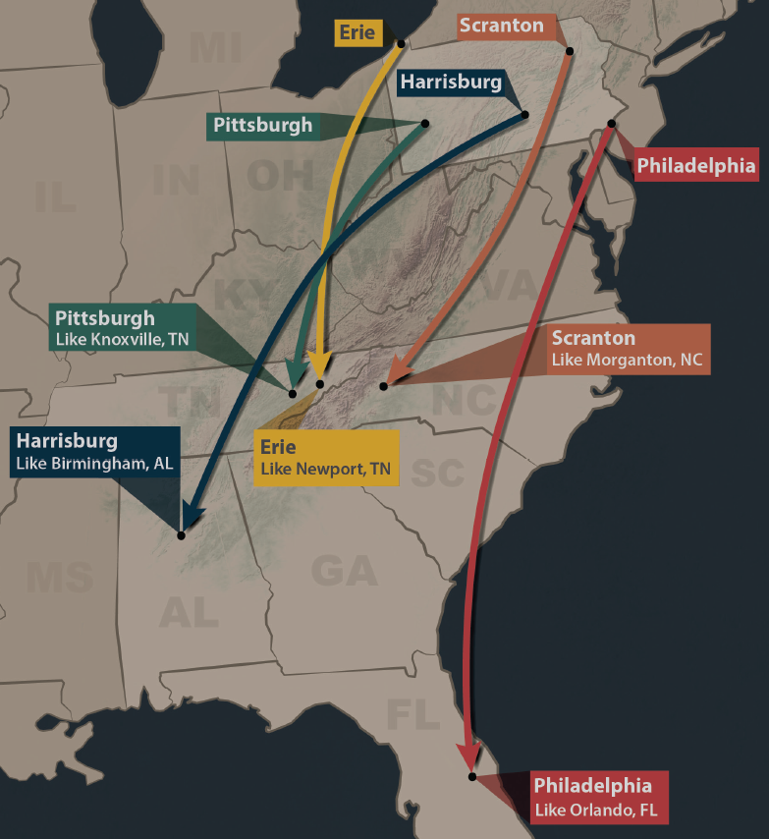
Summers in Pennsylvania will feel like those of the Southeast US by mid-century if heat trapping emissions trends continue
http://psiee.psu.edu/climate-impacts

Slide 3
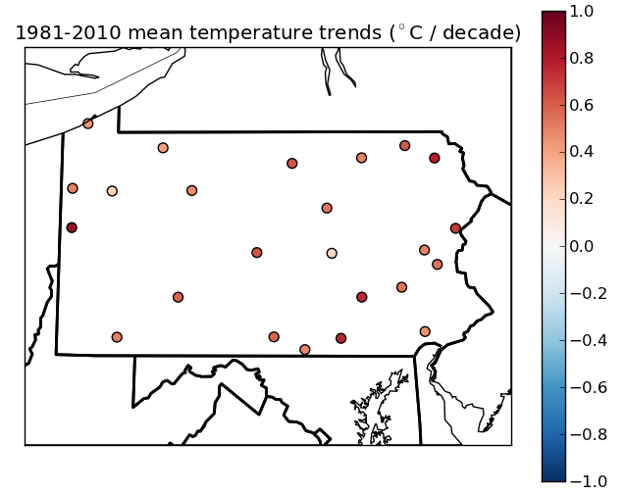
Pennsylvania is warming by 0.5 °F per decade
(°F/decade)
Shortle et al. (2013)
Notes:
Shortle, J., Abler, D., Blumsack, S., McDill, M., Najjar, R., Ready, R., Ross, A., Rydzik, M., Wagener, T., Wardrop, D., 2013. Pennsylvania Climate Impacts Assessment Update, Report to the Pennsylvania Department of Environmental Protection. Environment and Natural Resources Institute, The Pennsylvania State University, University Park, Pennsylvania, 155 pp.

Slide 4
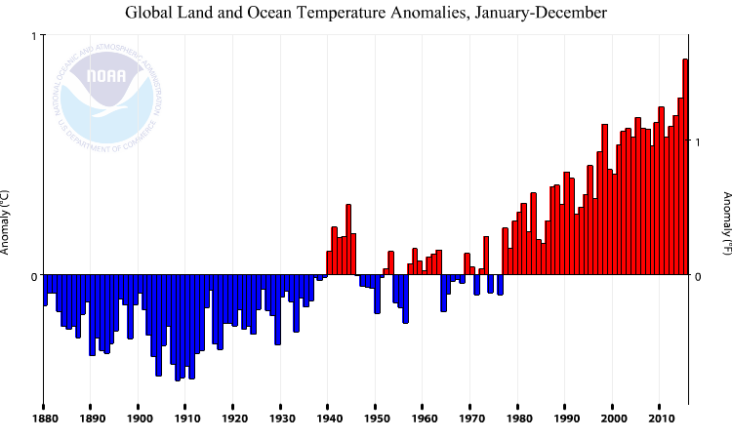
The Earth is rapidly warming
1 ºC
2015 was the warmest year on record by a large margin
1 ºF
0 ºC
0 ºF
1880 1900 1920 1940 1960 1980 2000

Slide 5
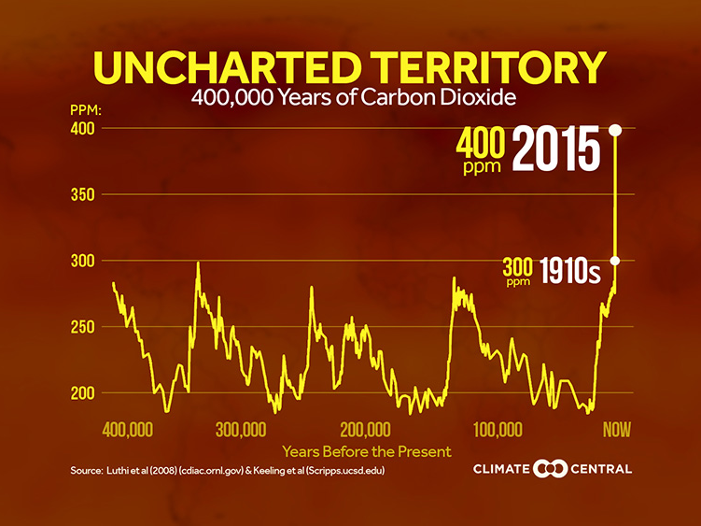

Slide 6


The greenhouse effect in three steps
1. Solar radiation warms Earth
2. Earth’s radiation absorbed in atmosphere
3. Atmosphere’s radiation further warms Earth—by 60 ºF

Slide 7
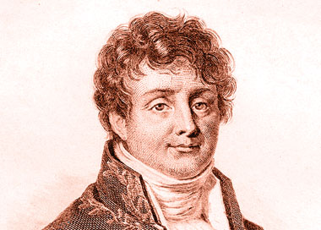
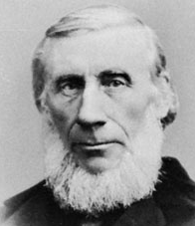
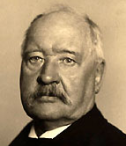

We have known about the greenhouse effect for almost two centuries
1824: Joseph Fourier describes natural greenhouse effect
1861: John Tyndall identifies greenhouse gases
1896: Svante Arrenhius estimates greenhouse effect of fossil fuel CO₂
1938: Guy Callendar documents warming and CO₂ increase

Slide 8
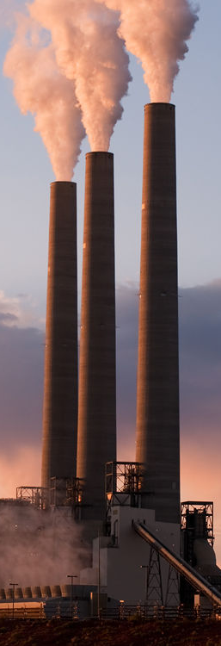
The US has emitted the most CO₂ …
Others
Others
India
EU
India
… despite its low population
US
EU
US
China
China
Image: Robert Fullerton/Shutterstock

Slide 9
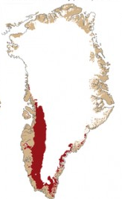
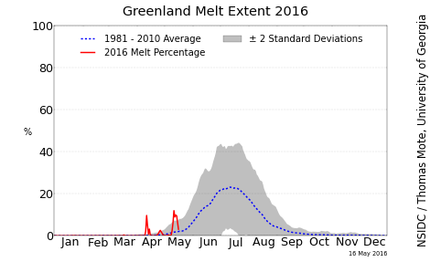
12% of Greenland Ice sheet surface was melting on April 11, 2016. Typically happens in June!
Melting
April 11, 2016
Source: National Snow and Ice Data Center & Danish Meteorological Institute

Slide 10
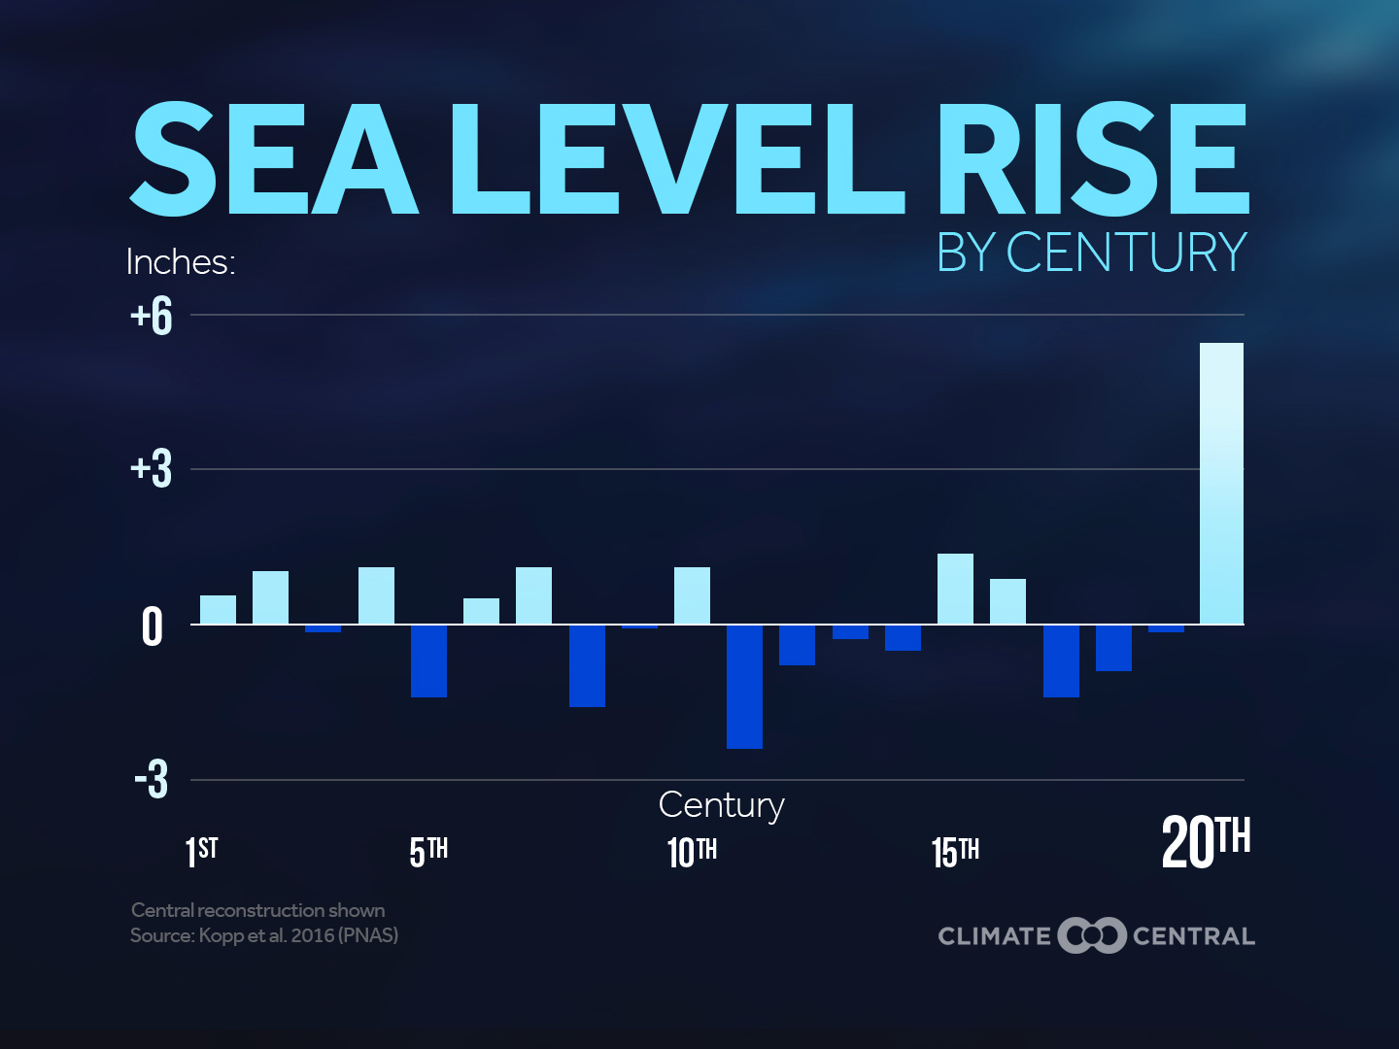

Slide 11
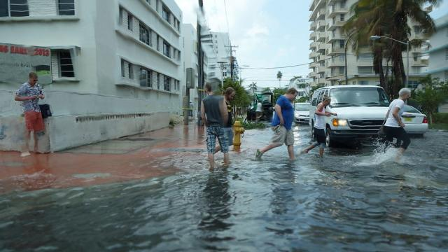
“Sunny day” flooding in Miami
Photo source: Grist

Slide 12
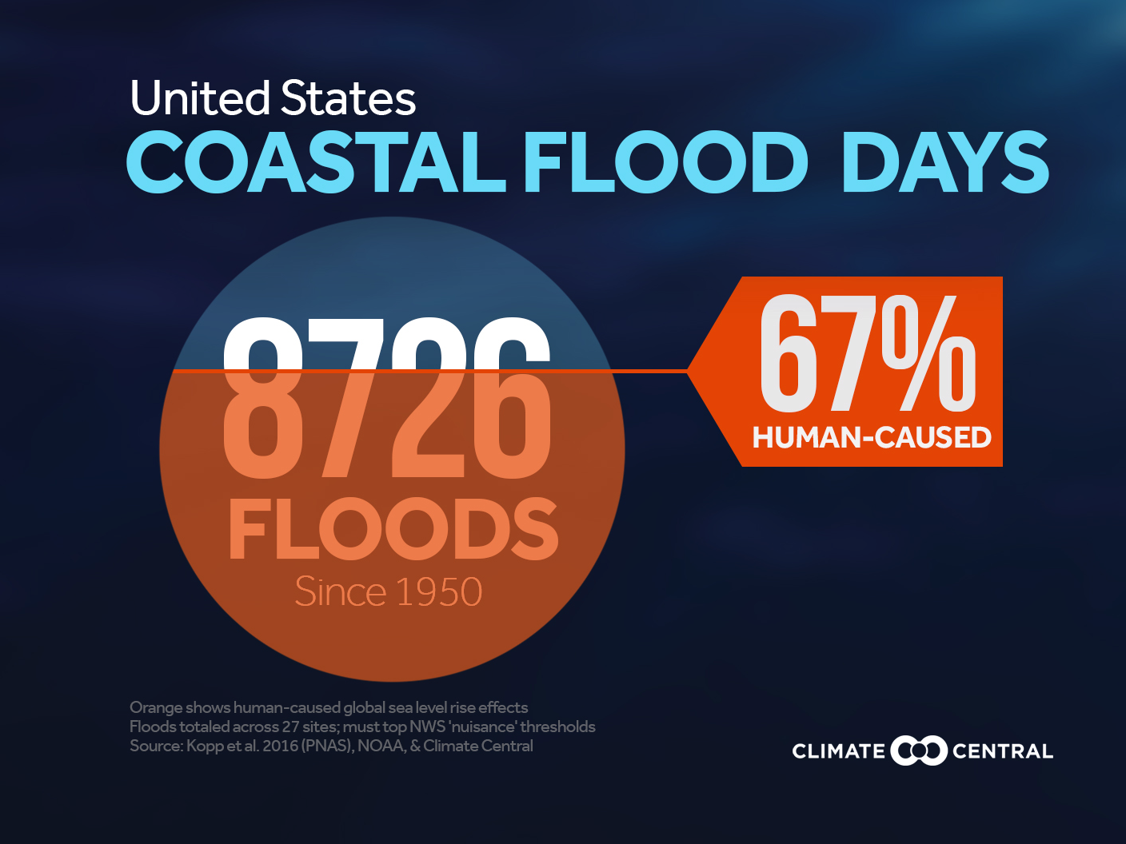

Slide 13
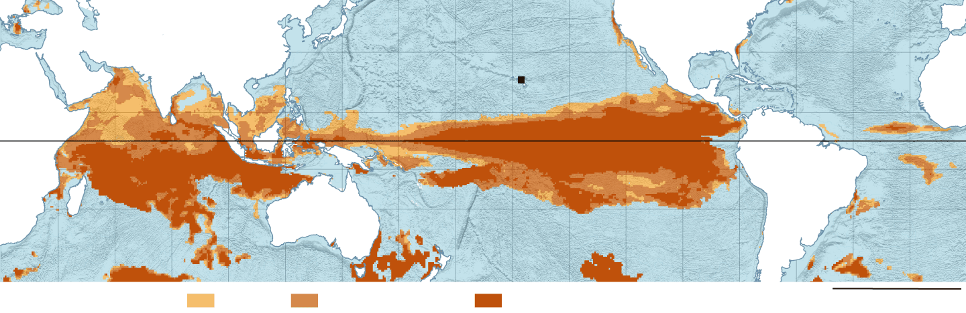
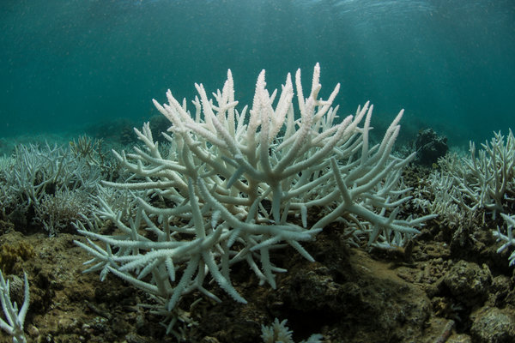

Massive coral bleaching is underway
Warning
Bleaching likely
Mortality
likely
Source: New York Times

Slide 14
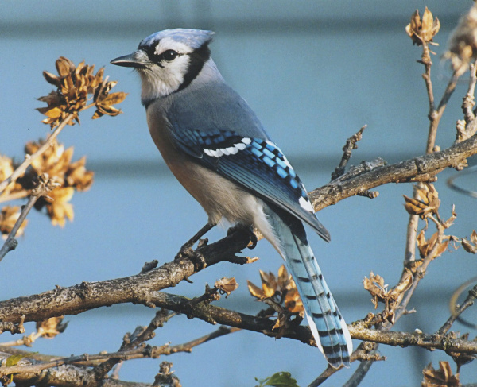
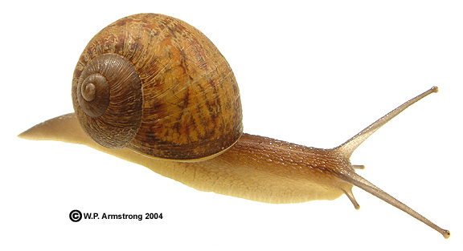
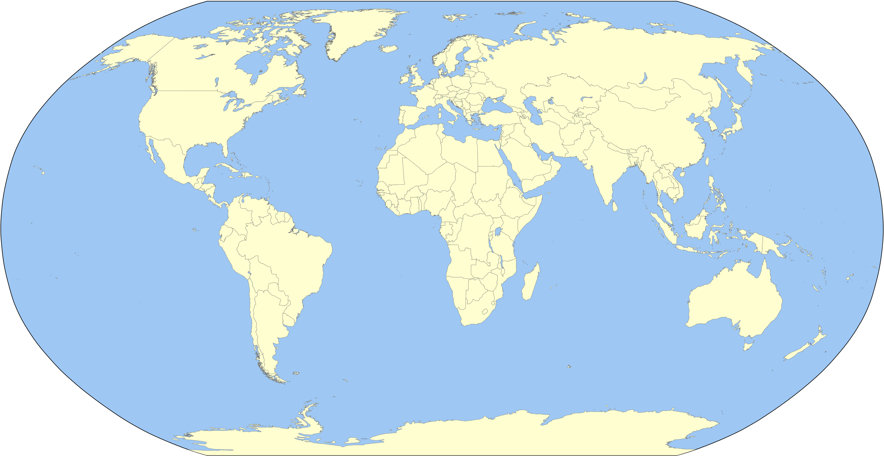

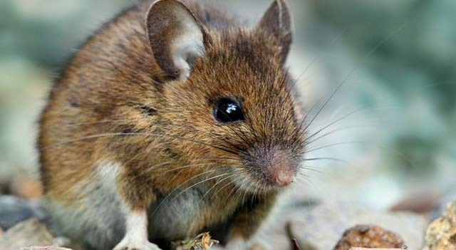
Animals are moving poleward
Birds
Mollusks
11 miles per decade
11 miles per decade
Mammals
Arthropods
Chen et al. (2011)
Notes:
www.encyclopedia.com, waynesword.palomar.edu, dispatch.com, liveanimalist.com, en.wikipedia.org
Chen, I.C., Hill, J.K., Ohlemüller, R., Roy, D.B., Thomas, C.D., 2011. Rapid range shifts of species associated with high levels of climate warming. Science 333, 1024-1026.

Slide 15
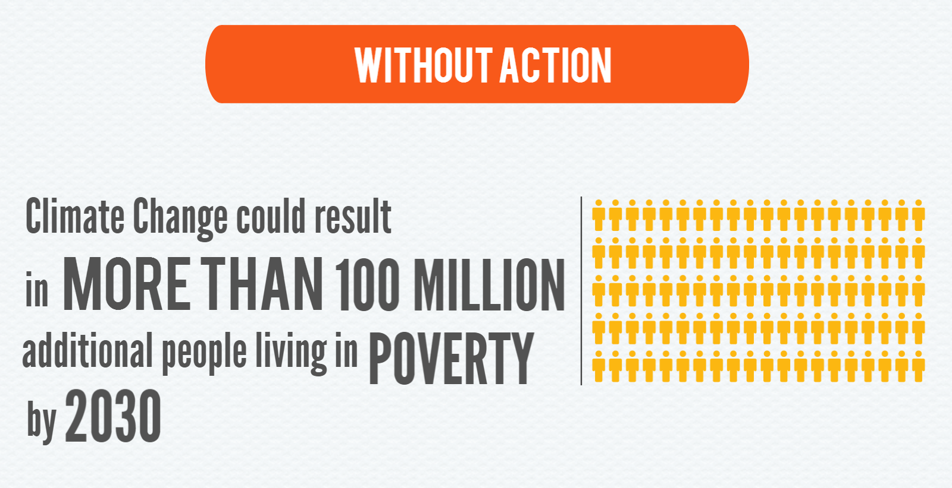

Hallegatte et al. (2016)
Notes:
Hallegatte, S., Bangalore, M., Bonzanigo, L., Fay, M., Kane, T., Narloch, U., Rozenberg, J., Treguer, D., Vogt-Schilb, A., 2016. Shock Waves: Managing the Impacts of Climate Change on Poverty. World Bank, Washington, DC, 207 pp.

Slide 16
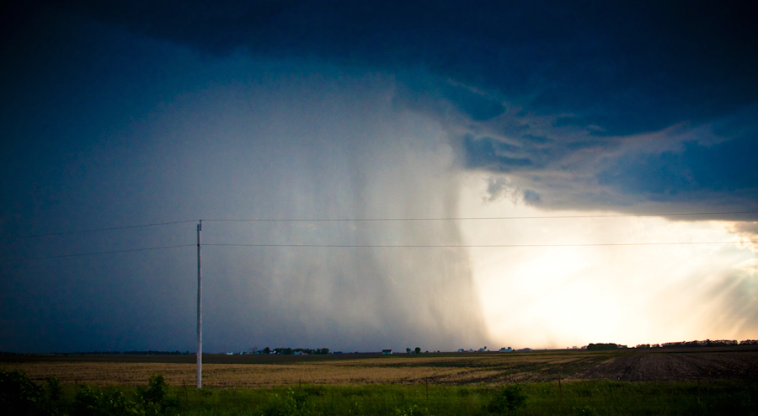
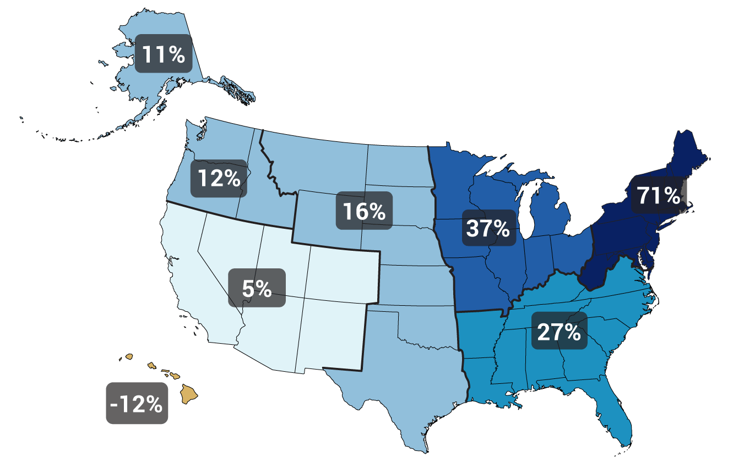
Heavy precipitation is increasing
Gustoflight.wordpress.com
Change in top 1% of rainiest days from 1958 to 2012
Walsh et al. (2014)
Notes:
Walsh, J., Wuebbles, D., Hayhoe, K., Kossin, J., Kunkel, K., Stephens, G., Thorne, P., Vose, R., Wehner, M., Willis, J., Anderson, D., Doney, S., Feely, R., Hennon, P., Kharin, V., Knutson, T., Landerer, F., Lenton, T., Kennedy, J., Somerville, R., 2014. Chapter 2: Our Changing Climate. In: J.M. Melillo, T.C. Richmond, G.W. Yohe (Editors), Climate Change Impacts in the United States: The Third National Climate Assessment. U.S. Global Change Research Program, pp. 19-67.

Slide 17
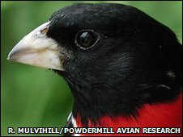
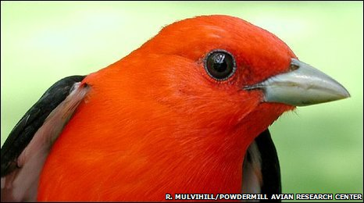
Birds in Western PA became smaller by 1.3% on average due to warming from 1961 to 2007
Scarlet tanager: 2% smaller
Rose-breasted grossbeak: 2% smaller
Van Buskirk et al. (2009, 2010)
Notes:
Van Buskirk, J., Mulvihill, R.S., Leberman, R.C., 2009. Variable shifts in spring and autumn migration phenology in North American songbirds associated with climate change. Global Change Biology 15, 760-771.
Van Buskirk, J., Mulvihill, R.S., Leberman, R.C., 2010. Declining body sizes in North American birds associated with climate change. Oikos 119, 1047-1055.

Slide 18
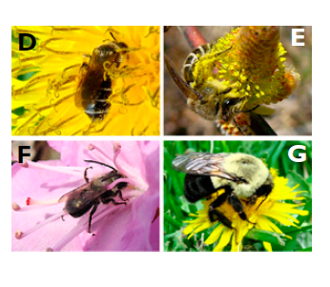
Native bees in Northeast US are arriving in spring 10 days earlier than they used to
A. miserabilis
C. inaequalis
O. lignaria
B. impatiens
Bartomeus et al. (2011)
Notes:
Bartomeus, I., Ascher, J.S., Wagner, D., Danforth, B.N., Colla, S., Kornbluth, S., Winfree, R., 2011. Climate-associated phenological advances in bee pollinators and bee-pollinated plants. Proceedings of the National Academy of Sciences 108, 20645-20649.

Slide 19
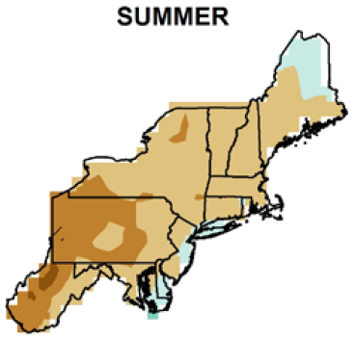
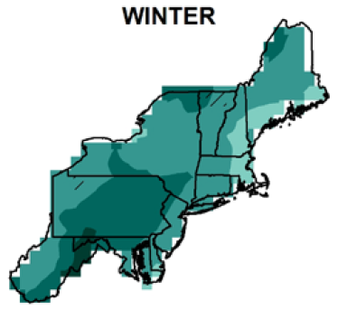

Expect summers to be drier …
… and winters to be wetter
0
8
12
-4
16
Percent precipitation change by 2050s
Kunkel et al. (2013)
Notes:
Kunkel, K.E., Stevens, L.E., Stevens, S.E., Sun, L., Janssen, E., Wuebbles, D., Rennells, J., DeGaetano, A., Dobson, J.G., 2013. Regional Climate Trends and Scenarios for the U.S. National Climate Assessment, Part 1. Climate of the Northeast U.S., NOAA Technical Report NESDIS 142-1. U.S. Department of Commerce, Washington, D.C., 79 pp.

Slide 20
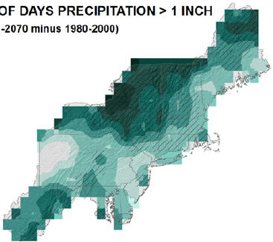

Expect heavy downpours to continue to increase
Percent change by 2050s in days > 1”
21
27
21
15
Kunkel et al. (2013)
Notes:
Kunkel, K.E., Stevens, L.E., Stevens, S.E., Sun, L., Janssen, E., Wuebbles, D., Rennells, J., DeGaetano, A., Dobson, J.G., 2013. Regional Climate Trends and Scenarios for the U.S. National Climate Assessment, Part 1. Climate of the Northeast U.S., NOAA Technical Report NESDIS 142-1. U.S. Department of Commerce, Washington, D.C., 79 pp.

Slide 21
The amount of climate change depends on the emissions path
Union of Concerned Scientists (2008)
Notes:
Union of Concerned Scientists, 2008. Climate Change in Pennsylvania: Impacts and Solutions for the Keystone State. Cambridge, MA, 54 pp.

Slide 22
One reason for hope:
Past successes
Notes:
Image istockphoto

Slide 23
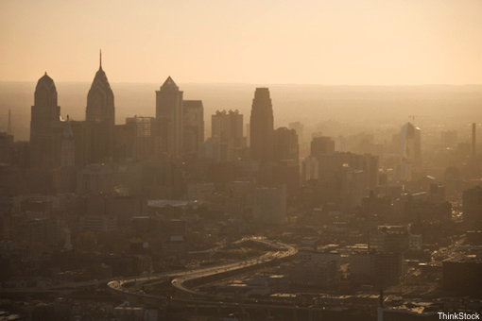
This is happening much less often than it used to
Ozone
NO₂
CO
SO₂
Lead
28%
52%
82%
83%
89%
Median change in US: 1980-2010
Data source: www3.epa.gov/airtrends

Slide 24
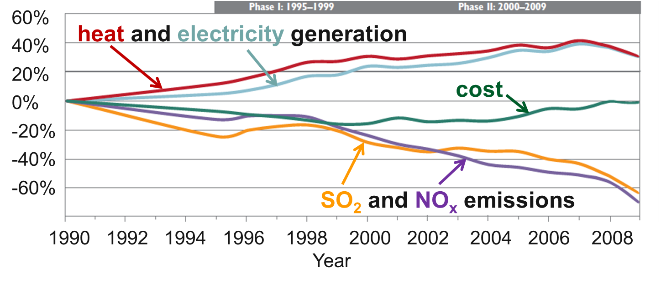
The Clean Air act reduced emissions and created $170 - $430 billion per year in health benefits—all while energy use went up and costs went down!
Burns et al. (2011)
Notes:
Burns, D.A., Baron, J.S., Cosby, B.J., Fenn, M.E., Lynch, J.A., 2011. National Acid Precipitation Assessment Program Report to Congress 2011: An Integrated Assessment. National Science and Technology Council, United States Government, Washington, D.C., 114 pp.

Slide 25

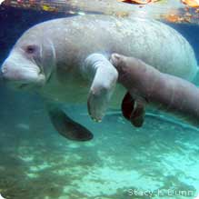
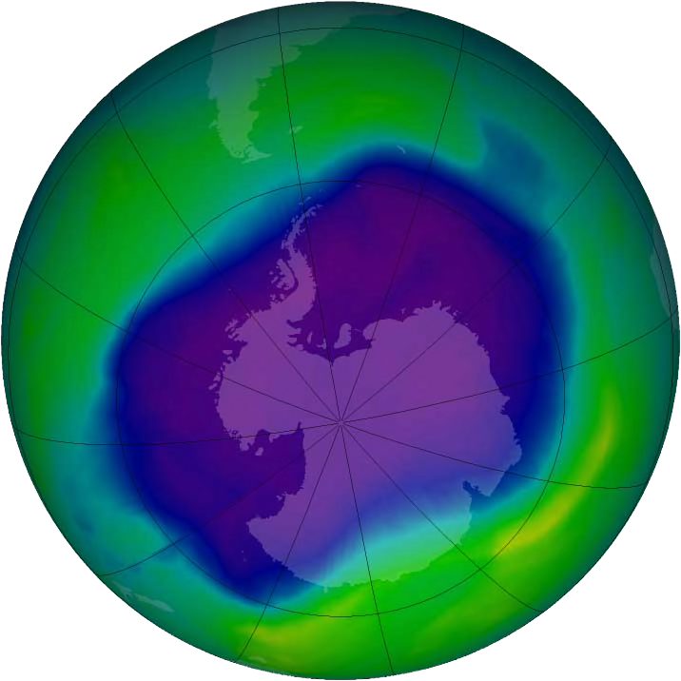
Other successes
Clean Water Act
Endangered Species Act
Montreal Protocol
Blog.nacwa.org, www.nwf.org

Slide 26
Another reason for hope:
People are responding

Slide 27





Paris Climate Conference 2015
Agreement to keep global warming well below 2.0 ºC (3.6 ºF)
Source: COP21 Paris

Slide 28
Progress, but we have a long way to go
Source: Climate Interactive

Slide 29
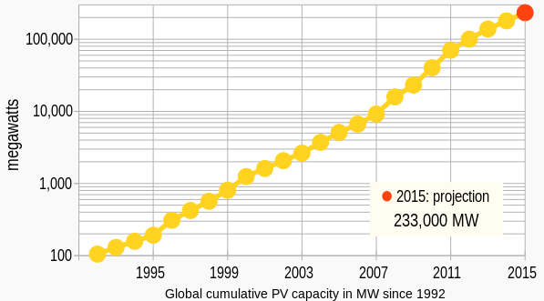
Solar energy production increased 2000-fold since 1992
34% increase in 2015!
Wikimedia commons and GTM research

Slide 30
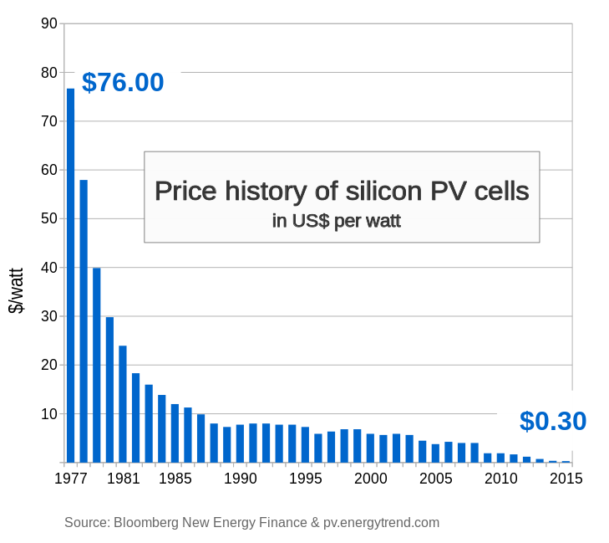
The cost to install solar has plummeted

Slide 31
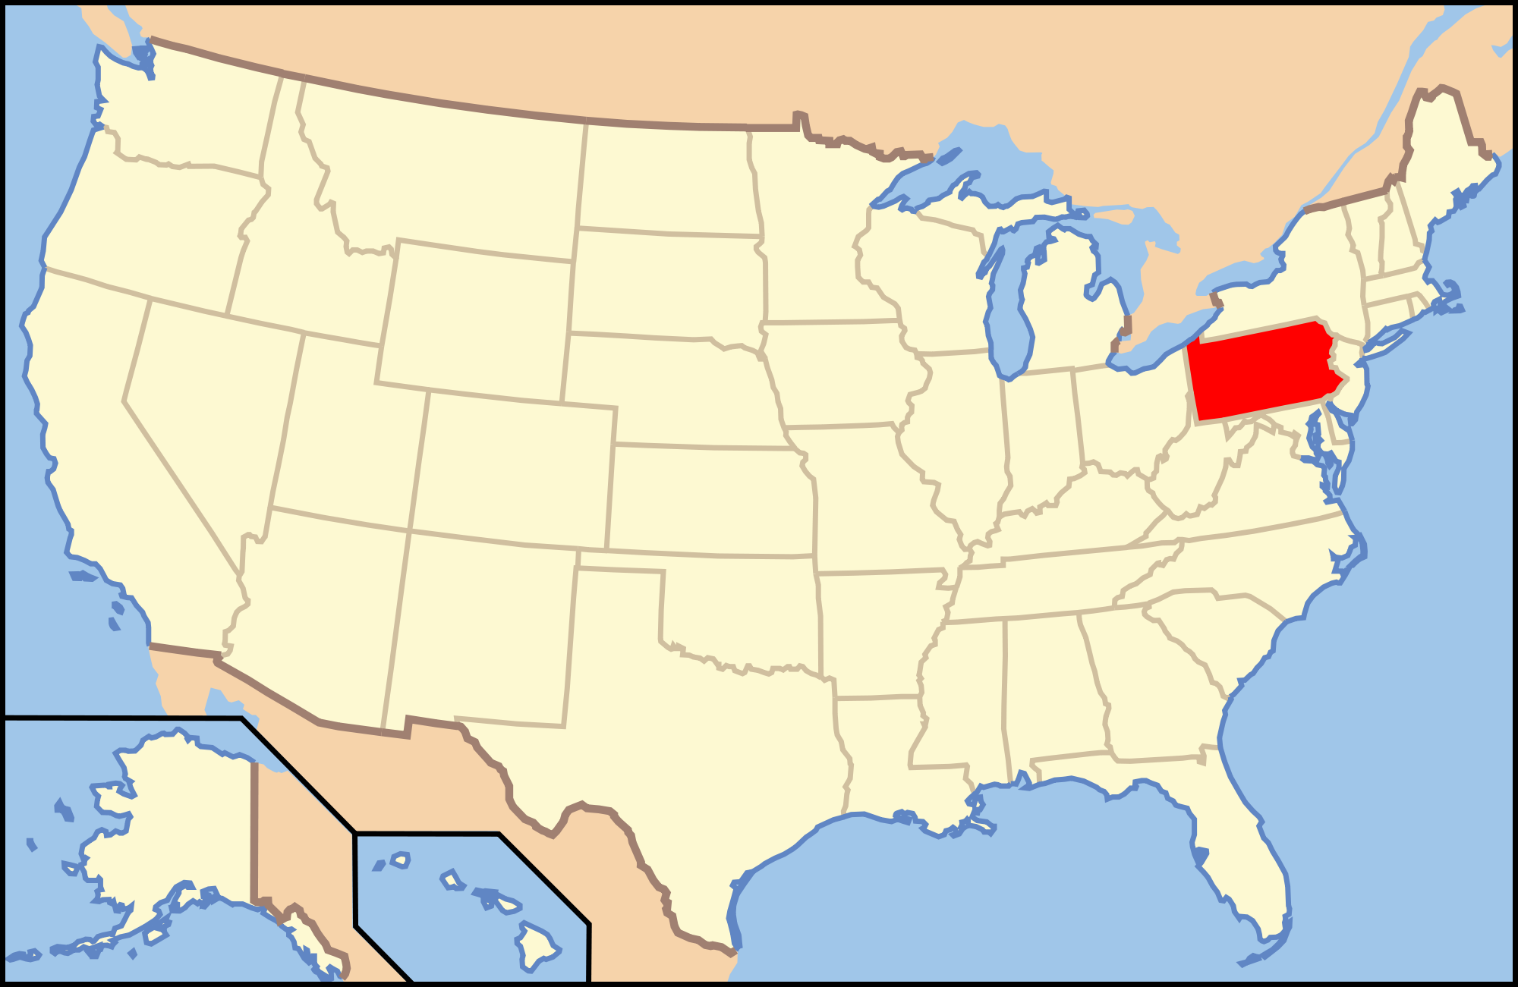
The amount of solar energy falling on half of PA is enough to support all US energy needs

Slide 32

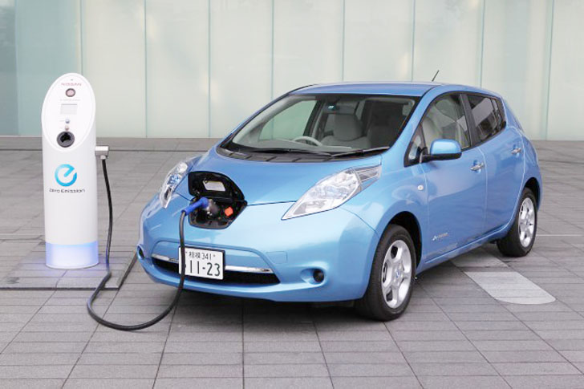

Three examples of national efforts:
The Clean Power Plan
Efficiency standards
Inhabit.com
energydigital.com
Carbon Tax or Emissions Cap

Slide 33
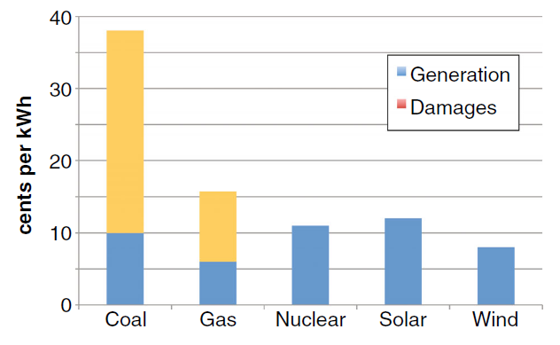
When damages to agriculture and health are considered, new electricity based on renewables is cheapest
Costs of new US electricity
Shindell (2015)
Notes:
Shindell, D.T., 2015. The social cost of atmospheric release. Climatic Change 130, 313–326.

Slide 34
2/3 of new electricity in the US in 2015 was renewable
Source: Federal Energy Regulatory Commission Energy Infrastructure Update

Slide 35


Two recommendations for homes and businesses
(1) Energy audit
(2) Purchase electricity from a renewable source

Slide 36

Be sure to choose:
FIXED rate
NO cancellation fee
100% renewable energy

Slide 37


Do individuals need to prepare for climate change?
It depends on the time frame.
Examples
Planting a vegetable garden?
Planting a tree?
dorshaktree.com
Consider passing on trees at their southern limit in PA, like the sugar maple
colegardens.com
Don’t worry about it

Slide 38
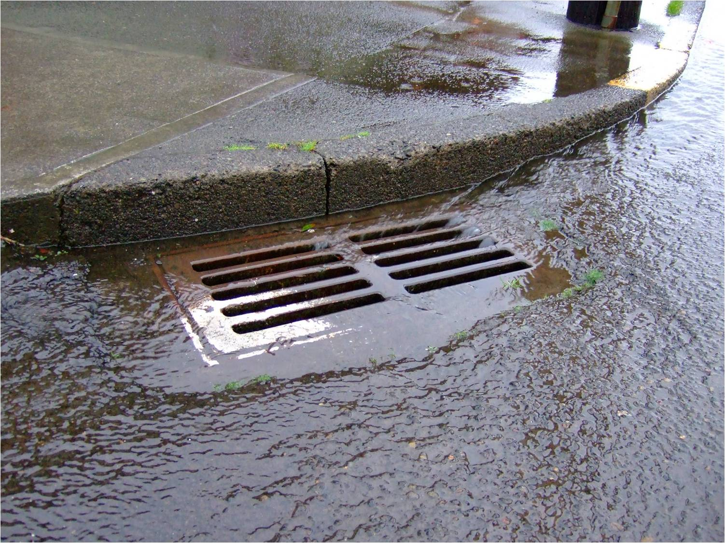
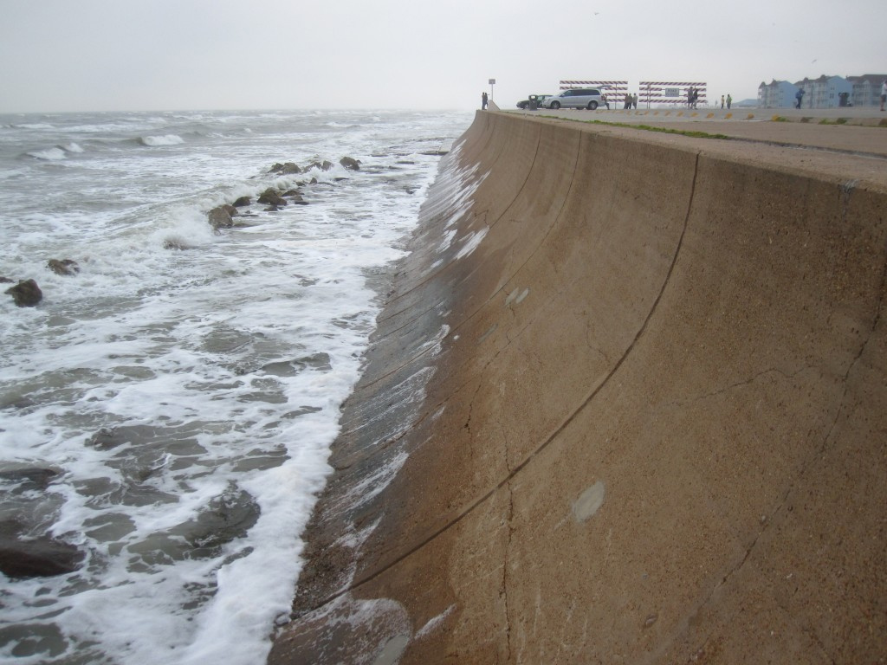
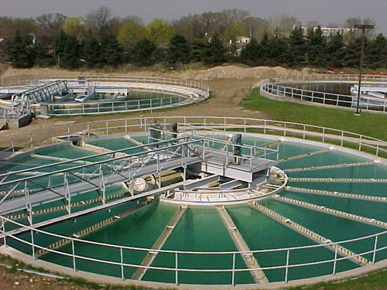


Do cities, states, and nations need to prepare for climate change?
Yes! Many decisions will be felt for decades.
Coastalnewstoday.com, www.eatoncounty.org, www.lakearrowhead.com, www.innovativewatertechnologies.co.in,

Slide 39
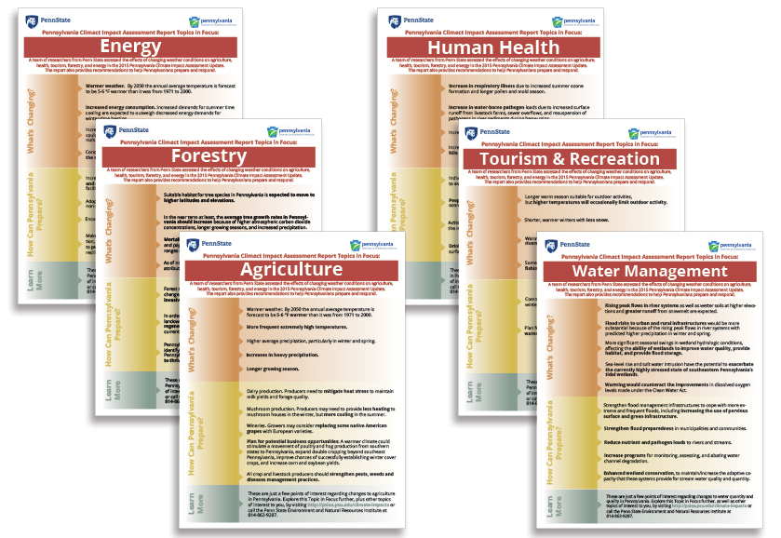
Education and adaptation are essential
Factsheets from the PA Climate Impacts Report
http://psiee.psu.edu/climate-impacts

Slide 40
Bottom lines about global warming:
It’s real
It’s us
It’s a serious threat
It’s solvable through emissions reductions and adaptation

